Slide 1

Football Player Analysis
Final Project
CSIT 275 Introduction to R Programming
Paul Ahn
Sai Moturi

Slide 2
Most Expensive Footballers 2021 Dataset
Description of the Dataset
The file players.csv dataset contains comprehensive information of Football players active in the European Premier Football league.
Dataset from Kaggle but has not been preprocessed in R.
Consisted of 500 rows and 16 columns.
Key fields include player’s Market Value, Age, Player’s Club, Player’s Country, Player’s position, etc.

Slide 3
Motivation
Analyze the data to identify patterns and investigate different factors to predict the future market value of players.
Utilize analytical techniques and methods to discover if there is any relationship between player’s age and market value.
Do players with higher market value tend to score more goals?

Slide 4
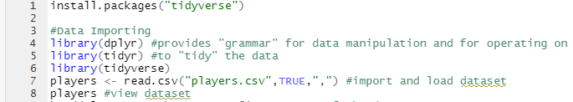
Data loading and exploration
Install packages in Tidyverse for data analysis
Import all the relevant packages for the analysis
Load the data
View the data

Slide 5

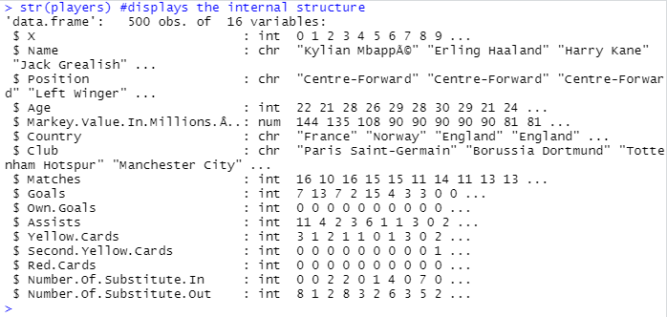
Data loading and exploration
Take a look at the first and last 5 rows of the dataset
Display the internal structure of the dataset
Display the dimension of the dataset

Slide 6
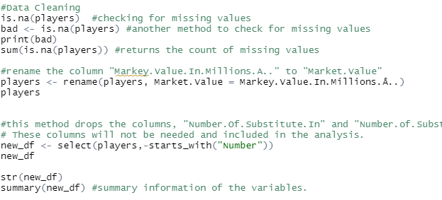
Data Cleaning
Check for missing values. This dataset contained 0 missing values.
Rename the column, “Markey.Value.In.Millions.A..” to “Market Value” for better understanding the variable.
Dropped the last two columns(not needed for this analysis).

Slide 7
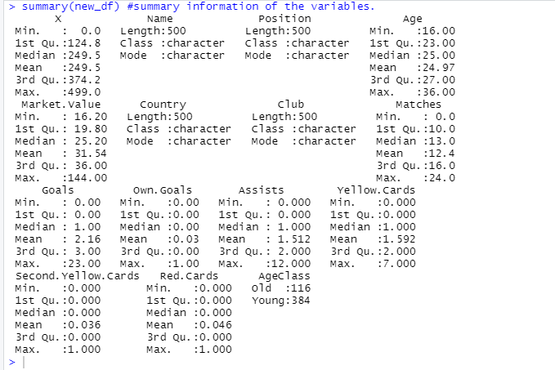
Data Cleaning
Summary of the new_df

Slide 8
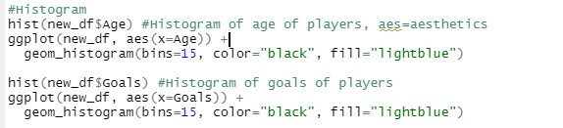
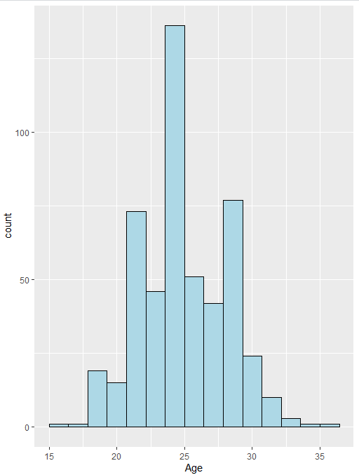
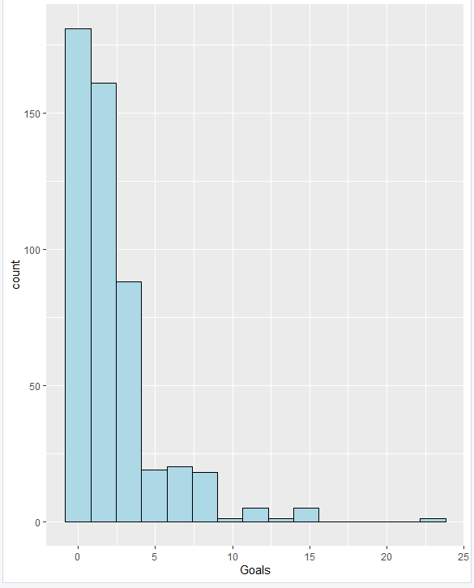
Histogram
Histogram of variable “Age”
Histogram of variable “Goals”

Slide 9
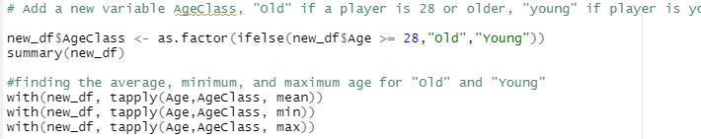
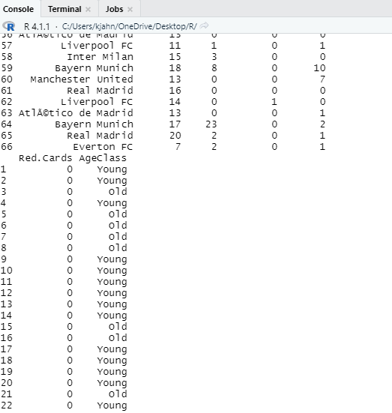
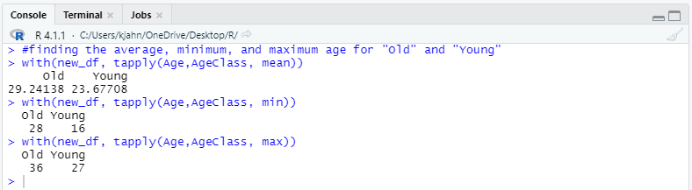
Exploratory Data Analysis
Added new variable “AgeClass”. Players under age 28 is “young” and if player is 29 or olders, “Old”
Display the average, minimum, and maximum age for AgeClass.

Slide 10
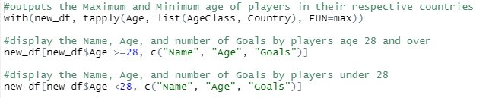
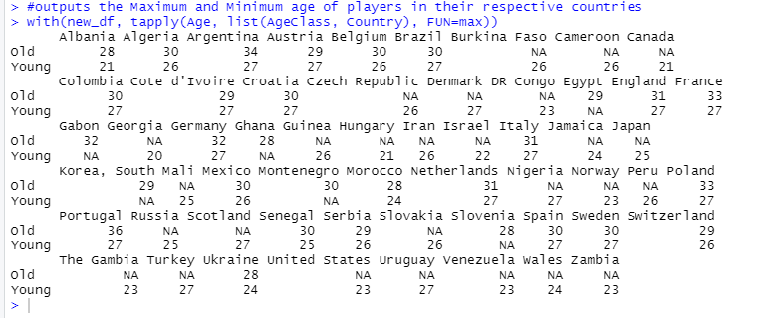
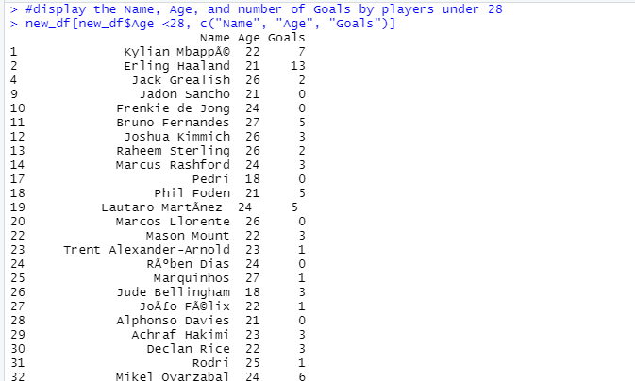
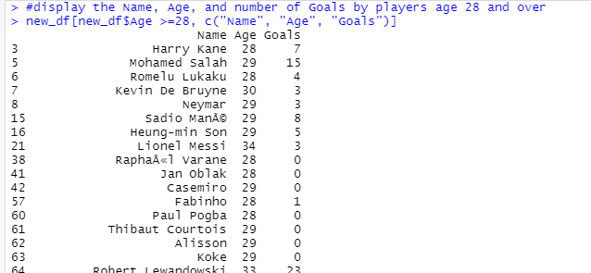
Exploratory Data Analysis
With the new variable “AgeClass”, display the maximum and minimum age of players in their respective countries.
Dipsplay the name, age and how many goals score depending on ageclass.

Slide 11
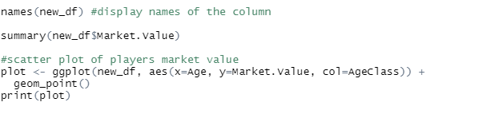
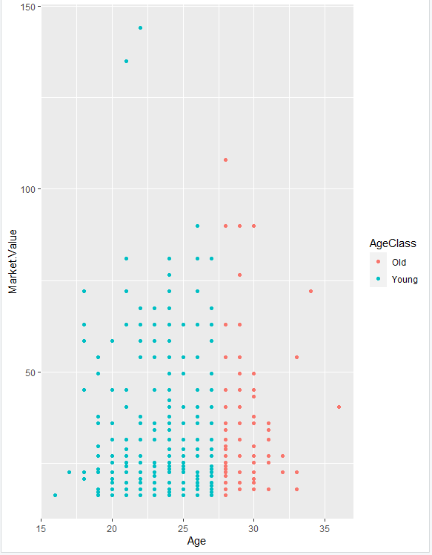
Exploratory Data Analysis
Scatter plot of Players age and their market value.

Slide 12
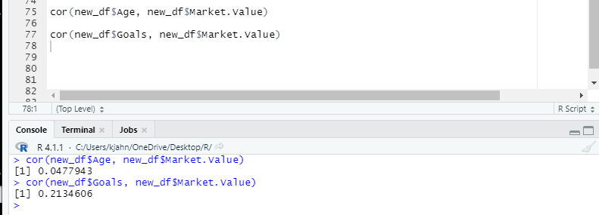
Exploratory Data Analysis
Relationship of variables age and market value.
Relationship of variables goals and market value.

Slide 13
Conclusion
Through the analysis, we were able to compare Market values of all the players in the European Premier football league.
We were able to determine that there is no relationship between player’s age and and market value.
Players with high market value does not tend to score more goals.
Oldest active player is 36 year old and youngest player is 16 years old.

Slide 14
References
https://www.kaggle.com/sanjeetsinghnaik/most-expensive-footballers-2021

